Slide 1





DATA WAREHOUSE FINAL PROJECT

Slide 2
Business Process
It was about analyzing and monitoring airline company process through out a lot of things and measure the customer satisfaction rate.

Slide 3
Granularity
We used the atomic approach by using smallest level of details (ticket data) to make it help us in the business process.

Slide 4

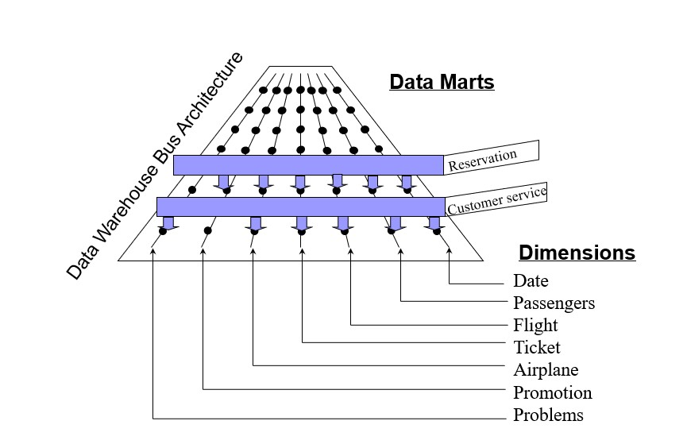
BUS MATRIX

Slide 5
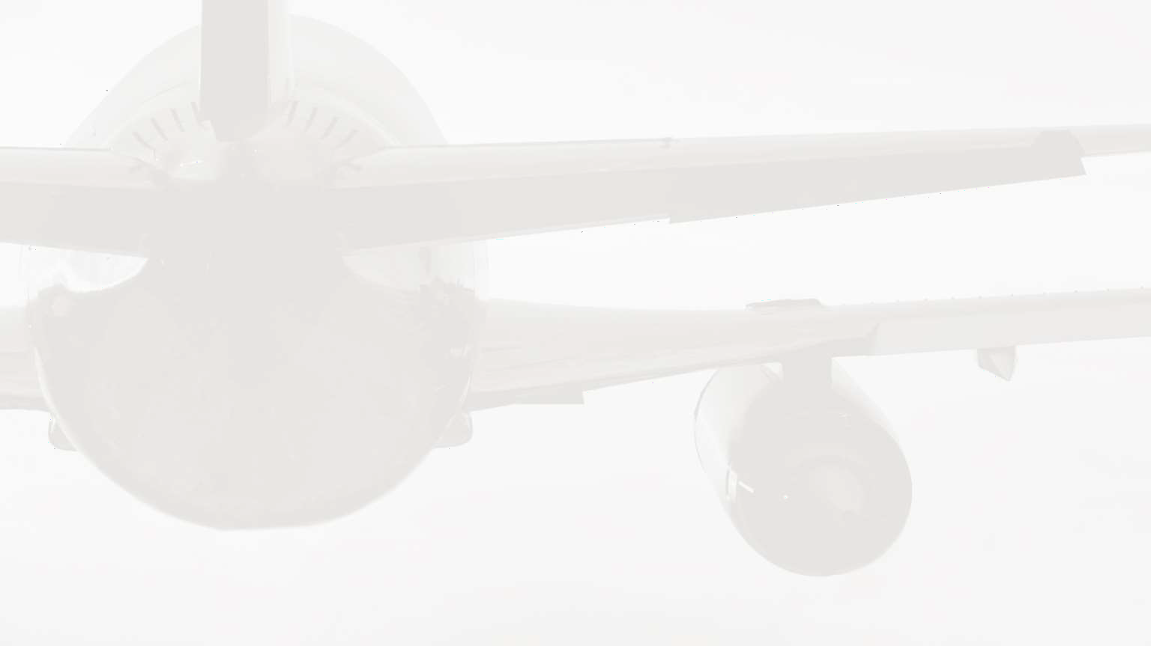
Modeling
Fact Tables
Reservation -- Customer Care
Dimensions
Date – Passenger – Flight – Airplane – Ticket – Promotions – Problem
So, we made the Galaxy Schema, and it was the best way to model our Business Process.

Slide 6




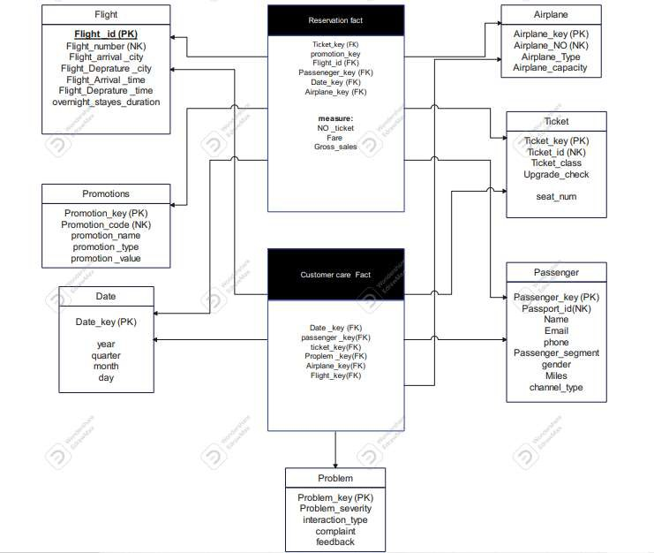

LOGICAL MODEL

Slide 7

Physical Design

Slide 8


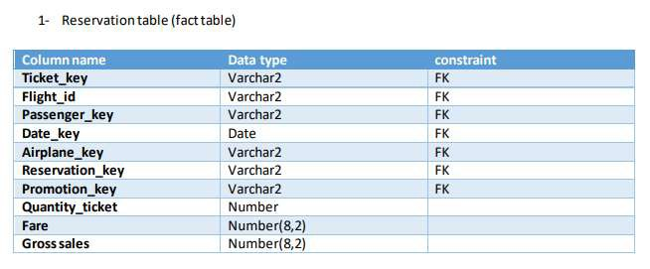
Reservation Fact Table
Represents each table transaction by passenger per each flight and including the date and the airplane all the reservation details if the passenger use any promotion.
The fare column represent the price per ticket also the fact include ticket quantity so we can calculate the gross sales.

Slide 9
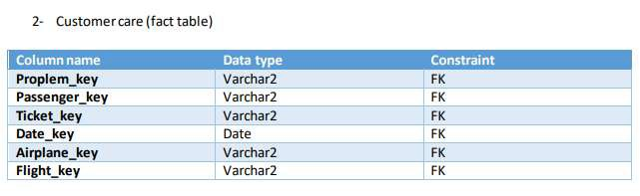
Customer Care Fact Table
Represents the measurement of the customer satisfaction rate by showing each single problem with below the details.

Slide 10
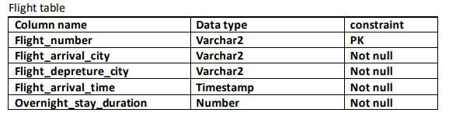
Flight Dimension Table
Represents the details of every flight as the date and flight number, and anything related to the flight information.

Slide 11
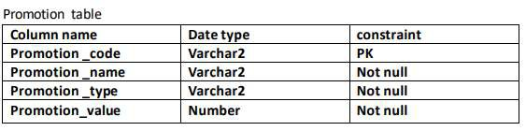
Promotion Dimension Table
Represents the offers and details of any discount that the customer can get with all the required details.

Slide 12
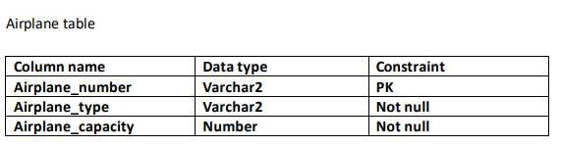
Airplane Dimension Table
Represents the details of the plane and it’s type and all the information about the plane capacity and so on.

Slide 13
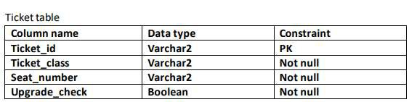
Ticket Dimension Table
Table Represents the details of the ticket
class and seat number and so on.

Slide 14
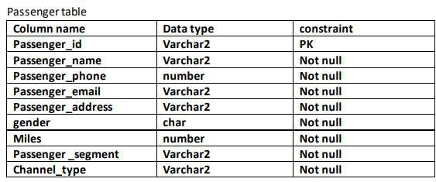
Passenger Dimension Table
Represents all the details about the passenger that already has an active ticket and will go on a flight.

Slide 15
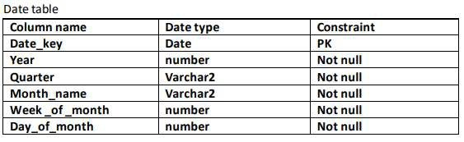
Date Dimension Table
Represents the timing and the accurate
details of the flight.

Slide 16
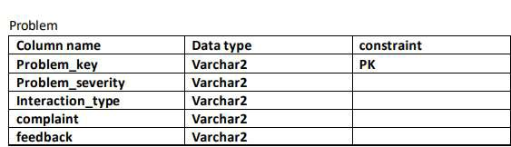
Problem Dimension Table
Represents any problem that occurs on the flight and the type of interaction that was taken with the problem.

Slide 17
SCREEN SHOOTS FOR SAMPLE DATA OF TABLES

Slide 18

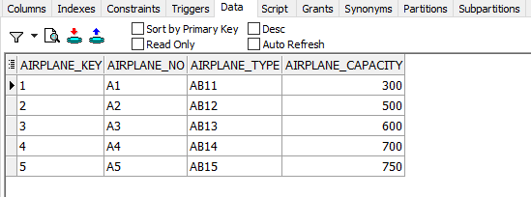

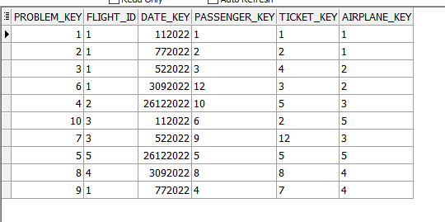
Airplane table
Customer Care

Slide 19

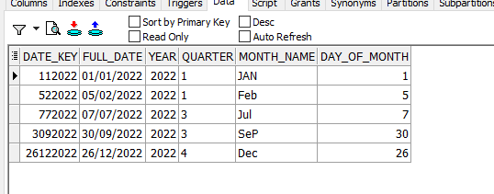

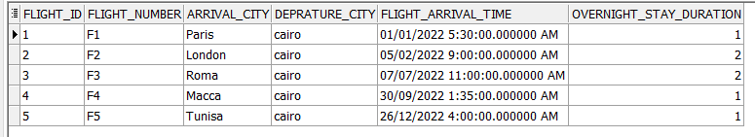
Date Dimension
Flight table

Slide 20

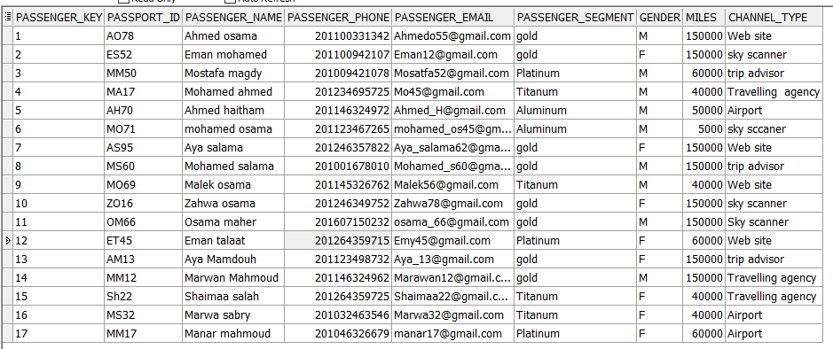
Passenger Table

Slide 21

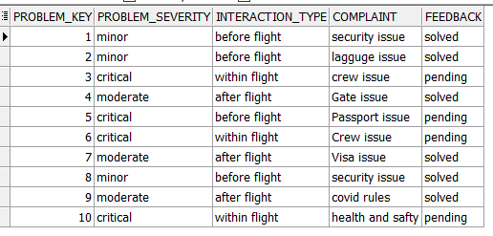

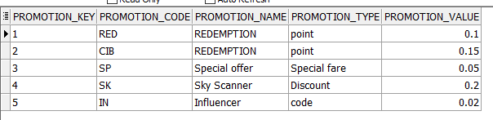
Problem Table
Promotion Table

Slide 22
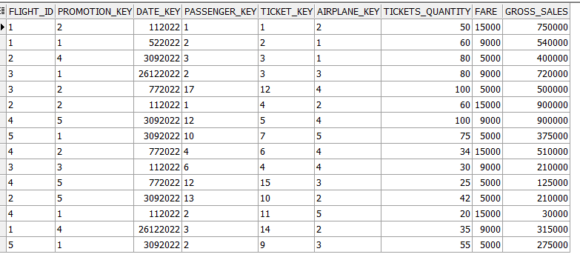
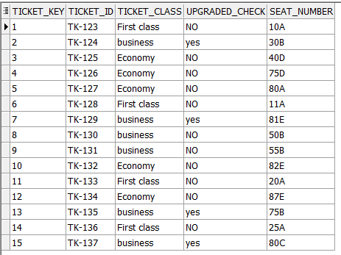
Reservation Table
Ticket Table

Slide 23
SCREEN SHOOTS FOR QUERIES

Slide 24



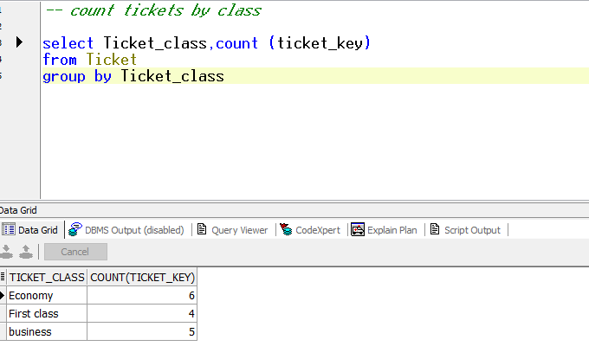
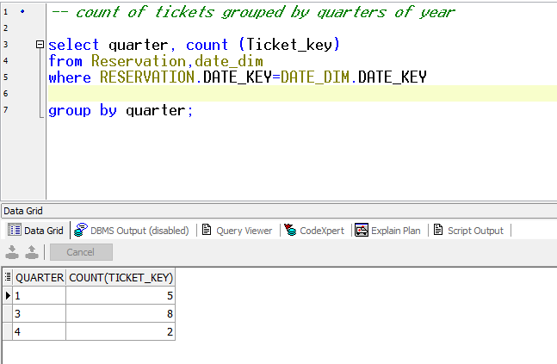
We need to enhance our marketing and gross sales in order to expanded our business.
Sales View

Slide 25

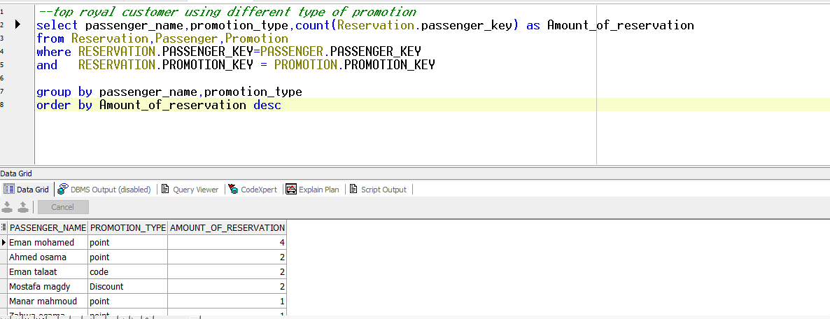
Now we need to make breakdown to our customers view to focused more on their satisfaction and needs, First we need to know the behavior of our loyal customer and if our offers and promotion meet their needs.
regarding this result we need to keep making our promotion program going as to keep out
loyal customer as the cuts interact with it and we find it very useful for our marketing goals

Slide 26

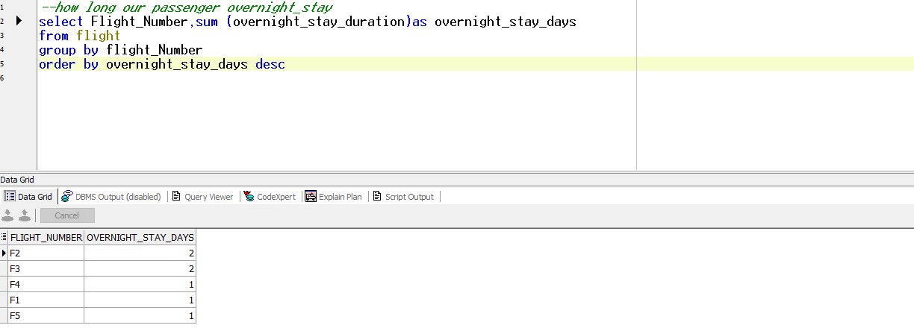
now we need to know how long our customer over night stays on our airport
so, we need to make on our consideration to provide restrooms for our passengers to make their flight more Comfort.

Slide 27

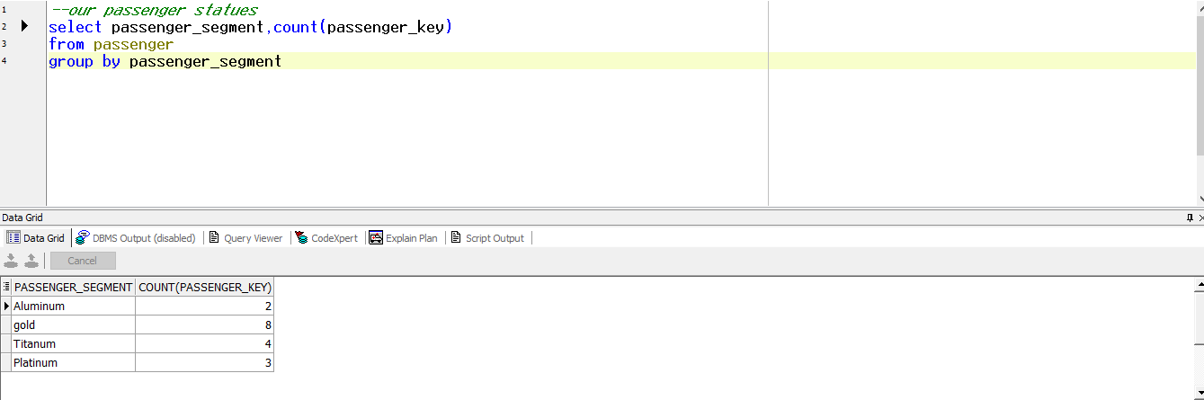
Details about our customer segment

Slide 28

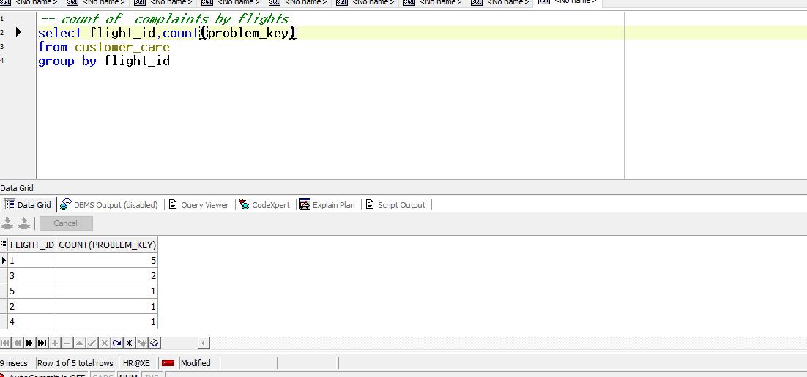
Now we need to focused on our customer complains and feedback to enhance our customer satisfaction rate
We need to analyze our problem to know the specific reason and solve it.

Slide 29
Regarding the above analysis Our decision- making team decided to
Make more promotion and discount to our loyal customer and the new customers to
expand our market share.
Focused more on digital marketing showing out promotion to catch our new customer
intention.
We need to provide our customer with suitable restrooms so they can overstay comfort.
We need to make training sessions for our crew about customer experience excellent
to avoid customer complains.

Slide 30
THANK YOU

